Slide 1

Cedarburg High School
Ski Racing
2025 Season
Coach : George Gruebling
Asst. Coach: Nikki Gruebling
262.210.0690
ggruebling@cedarburg.k12.wi.us
Ski Team Captains
Nicholas Hafner | Sasha Poss

Slide 2


Ski Racing Intro
Fastest non-motorized sport.
Will make you better at a lifelong sport
Great way to enjoy the winter
Shred GS
Shiffrin SL

Slide 3
Contact info
Fill out Google form at this link:
https://docs.google.com/spreadsheets/d/1YsSHIbblGpaDvtLPUXf_zEBDbc2aOW6TYh88zm3in6Y/edit?usp=sharing
Presentation will be available with links on the HS Website.
Cedarburg HS home page > CHS Athletics > Teams > Winter > Ski Team

Slide 4
How does Ski Racing Work
Team competition of individual contributors.
Sections - Varsity (V) and Junior Varsity (JV) Boys and Girls
6 racers per section – Varsity Boys & Girls / JV Boys & Girls
Top 4 times used for score (each racer gets 2 runs)
  Section score is sum of combined 1st and 2nd run time.
Everyone’s time counts. You never know when someone in your section or a competitor’s section will DNF, penalty, etc.
DNS – Did not Start / DNF – Did not Finish,

Slide 5
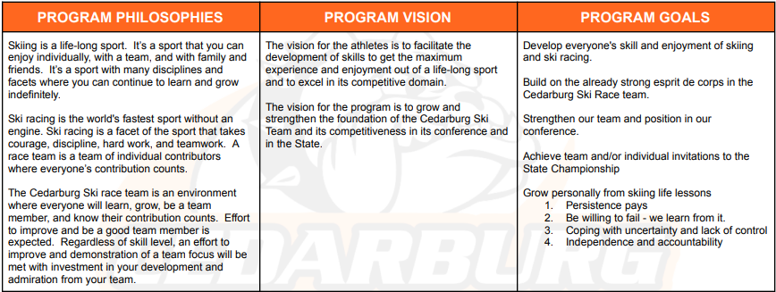
Team Philosophy

Slide 6
Schedule – season start Nov. 17th.
Practice – Little Switz (Late Dec.)
  Sundays at 6 PM
  Tuesdays at 6 PM
Dryland Training
  Outside and inside plyometrics and lifting
  Course/rules review, video, etc.
  Open gym starting week of 11/18 until snow.
    Time and days TBD
Additional Practices
  Parks Ski Team
  HH Ski Team
Race Schedule
Week | Date | Type | Venue | Extra
1 | Sun. 1/5 | GS | Crystal Ridge
2 | Thur. 1/9 | SL | Switz
3 | Thur. 1/16 | GS | HH
4 | Thur. 1/23 | SL | Sunburst | COR
5 | Thur. 1/30 | SL | Switz
6 | Wed. 2/5 | GS | Alpine | ACOR
COR – Chief of Race
ACOR – Assistant COR

Slide 7
Physical Clearance
Must have athletics registration complete and be cleared for practice.
Physicals dated after April 1st 2024 – No action
4/1/23 – 3/31/24 – Alternate Year Form
Prior to 4/1/23 – New Physical

Slide 8
MHSSC Registration
Midwest High School Ski Conference
midwesthighschoolski.com
Timely registration is critical
Will advise when open
sportsengine App – NA

Slide 9
Transport & Fees
Bus Service
First race to Crystal Ridge will be bussed. Likely Alpine Valley too.
Student carpooling not allowed
School cannot encourage parents to carpool
Fees
Finalizing race tickets
All fees to be paid on Skyward except for Sunburst

Slide 10
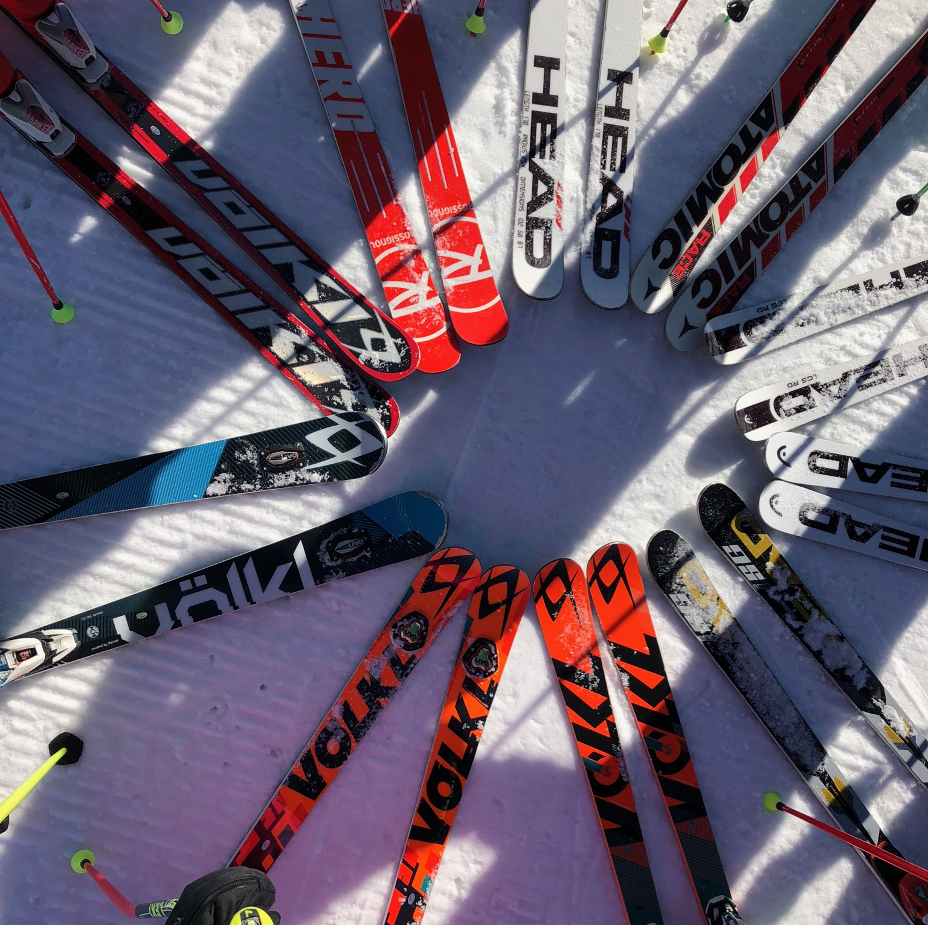
Equipment
Equipment List (on website)
  Minimum
    Skis (SL/GS) & Poles
    Boots
    Helmet
  Additional
    GS Skis (poles)
    Helmet bar
    Arm and shin guards
    Speed suit
    Training shorts

Slide 11
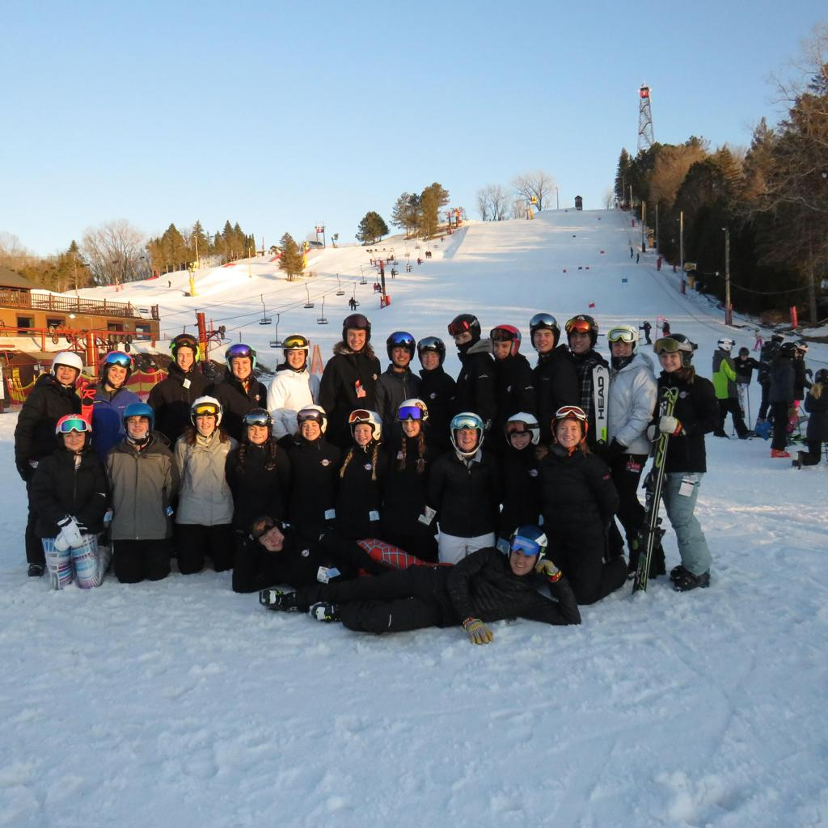
Parent Participation
Chief of Race (COR) / Assistant COR
  Timing, Gates, Starters, etc.
  Sign up genius
Transportation
  Van driving
  Car-pooling
Practice help/setup
Booster Club
Other costs:
  Gates
  Practice timer
  Banner
Team Mixer
TBD

Slide 12

Devils Head Camp
Timing depends on snow conditions
December 14th, 15th, 21st, or 22nd?
  Need to choose date and backup date
All day training camp
Cost includes bus and lift ticket
  Expect <$100

Slide 13
Spirit Wear
Store Closes November 17th
$3 per item goes to team
https://Masterprintwear.chipply.com/CHSSki/

Slide 14

Questions:
What did I miss?
How can we improve?
Where do I go with questions/suggestions?

